Slide 1
HTML Tables

Slide 2
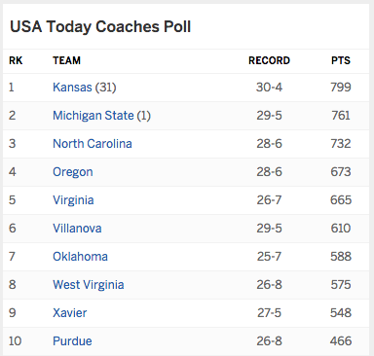
Tables display information in a grid
Source: http://espn.go.com/mens-college-basketball/rankings

Slide 3
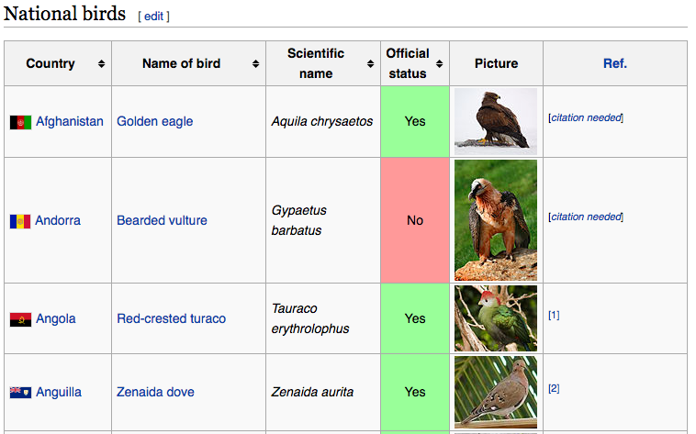
Tables display information in a grid
Source: https://en.wikipedia.org/wiki/List_of_national_birds

Slide 4
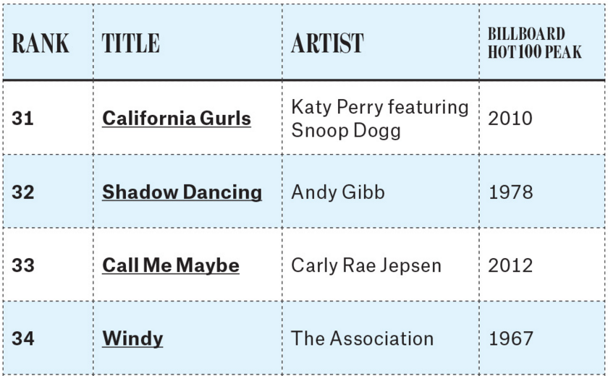
Table Terminology
Source: http://www.billboard.com/articles/columns/pop-shop/6634535/100-biggest-summer-songs-of-all-time

Slide 5
Table Terminology
Table
Source: http://www.billboard.com/articles/columns/pop-shop/6634535/100-biggest-summer-songs-of-all-time

Slide 6
Table Terminology
Table
Table row
Source: http://www.billboard.com/articles/columns/pop-shop/6634535/100-biggest-summer-songs-of-all-time

Slide 7
Table Terminology
Table
Table row
Source: http://www.billboard.com/articles/columns/pop-shop/6634535/100-biggest-summer-songs-of-all-time

Slide 8
Table Terminology
Table
Table row
Source: http://www.billboard.com/articles/columns/pop-shop/6634535/100-biggest-summer-songs-of-all-time

Slide 9
Table Terminology
Table
Table row
Source: http://www.billboard.com/articles/columns/pop-shop/6634535/100-biggest-summer-songs-of-all-time

Slide 10
Table Terminology
Table
Table row
Source: http://www.billboard.com/articles/columns/pop-shop/6634535/100-biggest-summer-songs-of-all-time

Slide 11
Table Terminology
Table
Table row
Table header
Source: http://www.billboard.com/articles/columns/pop-shop/6634535/100-biggest-summer-songs-of-all-time

Slide 12
Table Terminology
Table
Table row
Table header
Source: http://www.billboard.com/articles/columns/pop-shop/6634535/100-biggest-summer-songs-of-all-time

Slide 13
Table Terminology
Table
Table row
Table header
Source: http://www.billboard.com/articles/columns/pop-shop/6634535/100-biggest-summer-songs-of-all-time

Slide 14
Table Terminology
Table
Table row
Table header
Source: http://www.billboard.com/articles/columns/pop-shop/6634535/100-biggest-summer-songs-of-all-time

Slide 15
Table Terminology
Table
Table row
Table header
Table data
Source: http://www.billboard.com/articles/columns/pop-shop/6634535/100-biggest-summer-songs-of-all-time

Slide 16
Table Terminology
Table
Table row
Table header
Table data
Source: http://www.billboard.com/articles/columns/pop-shop/6634535/100-biggest-summer-songs-of-all-time

Slide 17
Table Terminology
Table
Table row
Table header
Table data
Source: http://www.billboard.com/articles/columns/pop-shop/6634535/100-biggest-summer-songs-of-all-time

Slide 18
Table Terminology
Table
Table row
Table header
Table data
Source: http://www.billboard.com/articles/columns/pop-shop/6634535/100-biggest-summer-songs-of-all-time

Slide 19
Table Terminology
Table
Table row
Table header
Table data
Source: http://www.billboard.com/articles/columns/pop-shop/6634535/100-biggest-summer-songs-of-all-time

Slide 20
Table Terminology
Table
Table row
Table header
Table data
Source: http://www.billboard.com/articles/columns/pop-shop/6634535/100-biggest-summer-songs-of-all-time

Slide 21
Table Terminology
<table> - container for all table data
Source: http://www.billboard.com/articles/columns/pop-shop/6634535/100-biggest-summer-songs-of-all-time

Slide 22
Table Terminology
<table> - container for all table data
<tr> - container for a single row
Source: http://www.billboard.com/articles/columns/pop-shop/6634535/100-biggest-summer-songs-of-all-time

Slide 23
Table Terminology
<table> - container for all table data
<tr> - container for a single row
Source: http://www.billboard.com/articles/columns/pop-shop/6634535/100-biggest-summer-songs-of-all-time

Slide 24
Table Terminology
<table> - container for all table data
<tr> - container for a single row
<th> - single table header element
Source: http://www.billboard.com/articles/columns/pop-shop/6634535/100-biggest-summer-songs-of-all-time

Slide 25
Table Terminology
<table> - container for all table data
<tr> - container for a single row
<th> - single table header element
Source: http://www.billboard.com/articles/columns/pop-shop/6634535/100-biggest-summer-songs-of-all-time

Slide 26
Table Terminology
<table> - container for all table data
<tr> - container for a single row
<th> - single table header element
<td> - single table data element
Source: http://www.billboard.com/articles/columns/pop-shop/6634535/100-biggest-summer-songs-of-all-time

Slide 27
Table Terminology
<table> - container for all table data
<tr> - container for a single row
<th> - single table header element
<td> - single table data element
Source: http://www.billboard.com/articles/columns/pop-shop/6634535/100-biggest-summer-songs-of-all-time

Slide 28
Table Example
<table>
All table information will go inside here
</table>

Slide 29
Table Example
<table>
<tr>
Information for the first row will go here
</tr>
</table>

Slide 30
Table Example
<table>
<tr>
Information for the first row will go here
</tr>
<tr>
Information for the second row will go here
</tr>
</table>

Slide 31
Table Example
<table>
<tr>
<th>Name</th>
<th>Points</th>
</tr>
<tr>
</tr>
</table>

Slide 32
Table Example
<table>
<tr>
<th>Name</th>
<th>Points</th>
</tr>
<tr>
</tr>
</table>
The first row usually contains headers
(<th>)

Slide 33
Table Example
<table>
<tr>
<th>Name</th>
<th>Points</th>
</tr>
<tr>
<td>Karel</td>
<td>32</td>
</tr>
</table>

Slide 34
Table Example
<table>
<tr>
<th>Name</th>
<th>Points</th>
</tr>
<tr>
<td>Karel</td>
<td>32</td>
</tr>
</table>
The rest of the rows contain data
(<td>)

Slide 35
Table Example
<table>
<tr>
<th>Name</th>
<th>Points</th>
</tr>
<tr>
<td>Karel</td>
<td>32</td>
</tr>
</table>

Slide 36
Table Example
<table>
<tr>
<th>Name</th>
<th>Points</th>
</tr>
<tr>
<td>Karel</td>
<td>32</td>
</tr>
</table>
Name | Points
Karel | 32
Preview

Slide 37
Table Example
<table border=“1”>
<tr>
<th>Name</th>
<th>Points</th>
</tr>
<tr>
<td>Karel</td>
<td>32</td>
</tr>
</table>
Name | Points
Karel | 32
The border attribute specifies how thick the table border is.
Default is 0.
Preview

Slide 38
Table Example
<table border=“1”>
<tr>
<th>Name</th>
<th>Points</th>
</tr>
<tr>
<td>Karel</td>
<td>32</td>
</tr>
</table>
Name | Points
Karel | 32
Preview

Slide 39
Table Example
<table border=“5”>
<tr>
<th>Name</th>
<th>Points</th>
</tr>
<tr>
<td>Karel</td>
<td>32</td>
</tr>
</table>
Name | Points
Karel | 32
Preview

Slide 40
Table Example
<table border=“0”>
<tr>
<th>Name</th>
<th>Points</th>
</tr>
<tr>
<td>Karel</td>
<td>32</td>
</tr>
</table>
Name | Points
Karel | 32
Preview

Slide 41
Table Example
<table border=“1”>
<tr>
<th>Name</th>
<th>Points</th>
</tr>
<tr>
<td>Karel</td>
<td>32</td>
</tr>
</table>
Name | Points
Karel | 32
Preview

Slide 42
Let’s see this in the editor!

